Slide 1
BUS RESERVATION SYSTEM
Prepared by
Gaurav Dinesh Sonkar
001888921

Slide 2
INTRODUCTION :
Bus Reservation System → Customer can go to the travel agents to book their ticket in advance instead of going to the bus stop on the day of journey with all the uncertainty of getting the seats.
And this helps the Bus owner as well, the bus owner can get to know the number of passengers travelling by particular bus so that he can decide on the demand & work on the supply accordingly.
Customer can also can cancel his ticket booked well in advance and the Bus owner has their own table where they have penalty set up for the cancellations and Discount on the some bookings.

Slide 3
Business Rules :
Here we have two sets of stakeholders → Customers and Employees.
Customers
Customers are welcome to book the buses well in advance depending on their need.
Customer needs to provide all the valid contact details while booking the ticket.
Customer needs to pay the fare to book the ticket, no partial payment.
Customer will be penalized if they plan on cancelling the ticket.
EMPLOYEES
Employees are asked to serve the customers with their need.
Employees will give their contact details while joining the firm.

Slide 4
Entity USED :
BusType → Busid (PK), BusNo.
BusSchedule → SchedID (PK), ScheduledDate, FromCity, ToCity, BusType(FK_BusType), NetBusFare(FK_BusFare).
BusFare → FareID(PK), Route (FK_Route), BusFare.
Route → RouteID(PK), BusStop, RouteCode.
Branches → BranchID(PK), Center, Address, Cityy(FK_Cities).
Cities → CityID(PK), CityName, State(FK_State).
States → StateID(PK), StateName.
ContactDetails → ContID(PK), Email, Telephone, City(FK_Cities).
Customers → CustID(PK), Name, Address, Age, Contacts(FK_ContactDetails).
Employee → EmpID(PK), Name, Address, Email, Tel, Branch (FK_Branches).
Discounts → DiscountID(PK), Description, Amount.
Penalty → PenaltyID(PK), Descrip, Amt.
Reservation → BookingID(PK), BookingDate, DepartureDate, Type, TotalFare, Customer (FK_Customers), Bus(FK_BusSchedule), Employee(FK_Employee), Penaltyy(FK_Penatly), Discounts (FK_Discounts)

Slide 5
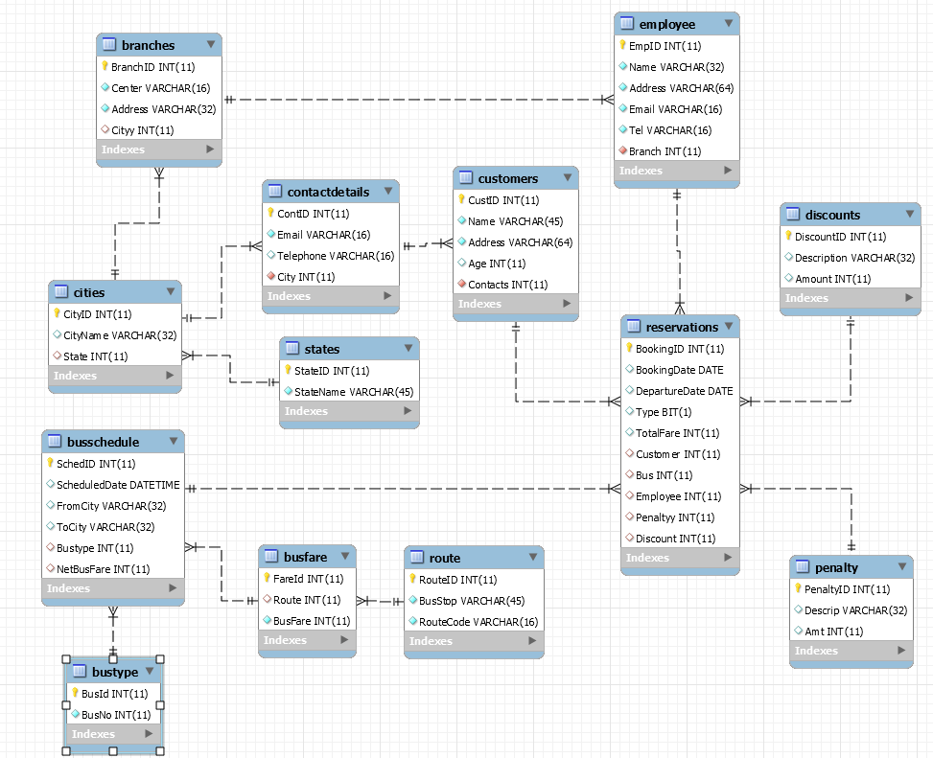
ER Diagram :

Slide 6
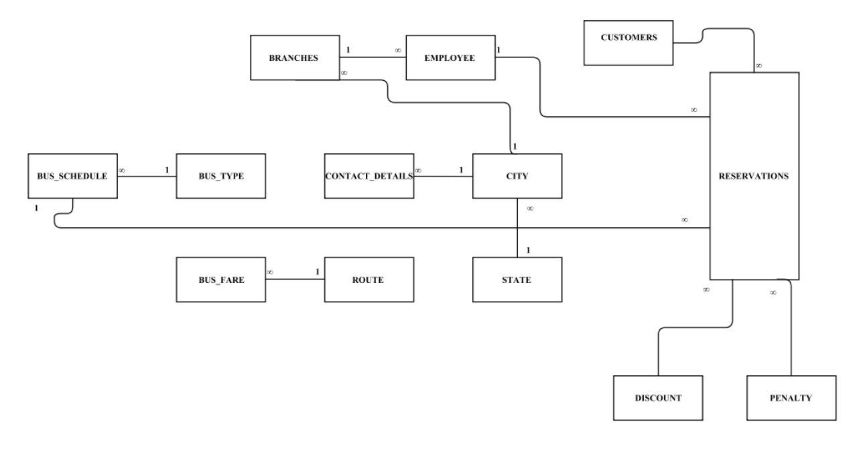

Slide 7
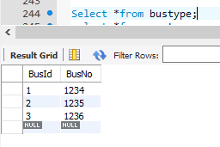
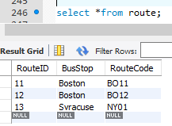
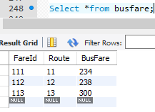
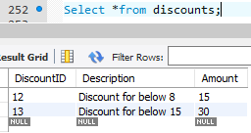
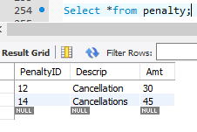
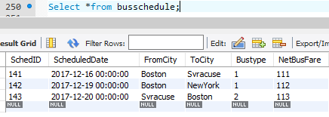
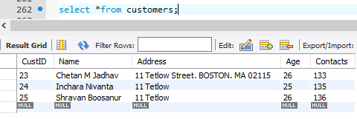
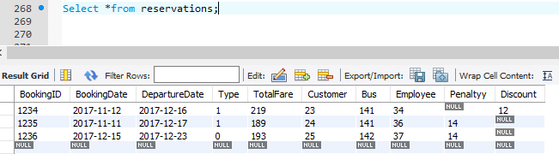
Look Up Entities :

Slide 8
Normalization, Triggers & Procedures :
All the tables in the Bus Reservation System are in 3rd Normalized form.
I have used two triggers to populate the fare of the ticket and the total fare to be refunded in case of cancellation.
Created 2 Stored Procedures to insert the Customer and Employee table.

Slide 9
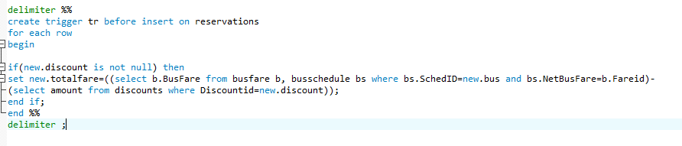
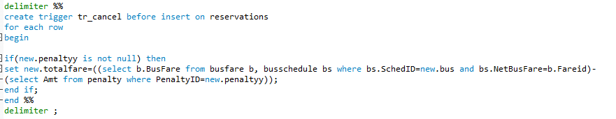
Triggers :
Trigger to add the total fare with removing discount amount if there is any discount is applicable.
Trigger to calculate the total amount to refund after customer plan to cancel his ticket.

Slide 10
Stored Procedures :
Stored Procedure Customer_Entry added to insert the details of customers to Customers Table.
Stored Procedure Employee_Entry added to insert the details of Employee to Employees Table.

Slide 11
*** THE END ***

